Slide 1
The Invalid’s Story by Mark Twain
In addition to this review, you may want to read the enotes study guide on the handouts and worksheets page

Slide 2
Vocabulary
term: synonym: antonym:
prodigious huge tiny
judicious sensible unreasonable
deleterious harmful beneficial
placidly peacefully excitably

Slide 3
Grammar: Active and Passive Voice

Slide 4
Grammar: Active and Passive Voice

Slide 5
Grammar: Active and Passive Voice

Slide 6
Grammar: Active and Passive Voice
Practice A Read each sentence and identify its verb or verb phrase. Identify each verb’s or verb phrase’s voice and tense as active or passive.
1. The story about the man on the bridge was told
to send a message.
2. She watches them in angry silence.
3. Granddaddy Cain greets Camera and Smilin.
4. The film was pulled out from the camera.

Slide 7
Grammar: Active and Passive Voice
Practice A Read each sentence and identify its verb or verb phrase. Identify each verb’s or verb phrase’s voice and tense as active or passive.
1. The story about the man on the bridge was told
to send a message. (P)
2. She watches them in angry silence. (A)
3. Granddaddy Cain greets Camera and Smilin. (A)
4. The film was pulled out from the camera. (P)

Slide 8
Grammar: Active and Passive Voice
Practice B Rewrite the following sentences using active voice and tenses. You may need to add words to indicate who performed the action.
1. The cheese had been placed on the box.
2. “The Invalid’s story was written by Mark Twain.
3. The coffin was sent to Wisconsin by train.
4. A foul odor was detected by the narrator.

Slide 9
Grammar: Active and Passive Voice
Practice B Rewrite the following sentences using active voice and tenses. You may need to add words to indicate who performed the action.
1. The man placed the cheese on the box.
2. Mark Twain wrote “The Invalid’s Story.”.
3. The narrator sent the coffin to Wisconsin by train.
4. The narrator detected a foul odor.

Slide 10
Grammar: Active and Passive Voice
Which sentence is in the active voice?
The white pine box was put onto the train.
A lot of chicken feathers were brought by Thompson.
The window was broken.
I've got an idea.

Slide 11
Grammar: Active and Passive Voice
Which sentence is in the active voice?
The white pine box was put onto the train.
A lot of chicken feathers were brought by Thompson.
The window was broken.
I've got an idea.

Slide 12
Grammar: Active and Passive Voice
Which sentence is in the passive voice?
We were taken from the platform.
It was only a harmless box of rifles.
John B. Hackett is dead.
Thompson bought dried apples.

Slide 13
Grammar: Active and Passive Voice
Which sentence is in the passive voice?
We were taken from the platform.
It was only a harmless box of rifles.
John B. Hackett is dead.
Thompson bought dried apples.

Slide 14
Literary Analysis: Dialogue and Dialect

Slide 15
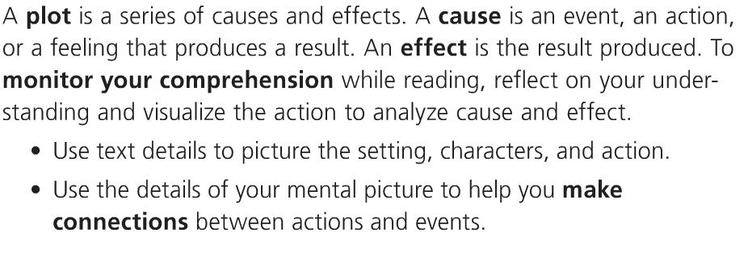
Reading Skill: Cause and Effect

Slide 16
Critical Reading
Who is the invalid referred to in the story's title, "The Invalid's Story"?
The narrator is the invalid referred to in the title.

Slide 17
Critical Reading
The plot of "The Invalid's Story" centers on confusion about
The confusion centers on what is in the long white-pine box.

Slide 18
Critical Reading
What is the setting for "The Invalid's Story"?
The setting is a train from Cleveland to Wisconsin.

Slide 19
Critical Reading
What literary element does this passage from "The Invalid's Story" illustrate? "Pfew! I reckon it ain't no cinnamon't I've loaded up thish-year stove with!“
dialect
or
simile
dialect

Slide 20
Critical Reading
In "The Invalid's Story," which word best describes how the narrator feels when he begins to smell the foul odor in the railroad car?
embarrassed
or
angry
embarrassed

Slide 21
Critical Reading
In "The Invalid's Story," when does Mark Twain uses dialect in the narrator's comments or in those by Thompson?
in Thompson’s

Slide 22
Critical Reading
Thompson gives a long speech about the fact that death is inevitable for all human beings.
Why do you think Twain includes this long speech?
Because it shows that Thompson is a brilliant philosopher
or
because it adds humor to the story
it adds humor

Slide 23
Critical Reading
Read the following idiom from the story: "Well-a-well, we've all got to go, they ain't no getting around it.” Which best expresses the meaning of the underlined words?
There are ways to avoid it,
or
there is no way to avoid it.
There is no way to avoid it.

Slide 24
Critical Reading
The narrator of "The Invalid's Story" says that "the news was too late to save me; imagination had done its work, and my health was permanently shattered."
According to the narrator, what has caused the permanent breakdown in his health imagination or overwork?
imagination

Slide 25
Critical Reading
In "The Invalid's Story," why do the two men light up cigars to "modify" the unpleasant odor in the express car, or to keep warm?
The men want to "modify" the unpleasant odor in the express car.

Slide 26
Essay You will not write your essays until Friday
Start Thinking about these prompts:
In an essay, describe how Twain uses images of smell in "The Invalid's Story" to create the story's humor. Mention one specific example from the story.
Dialect is a way of speaking that is common to people of a particular region or group. In an essay, discuss Mark Twain's use of dialect in "The Invalid's Story." Where, specifically, does Twain use dialect in the story? How does dialect add to the story's vivid setting and its humor?

